Slide 1
Qingdao Haicheng Tongda Industry & Trade Co.,Ltd
Product Information
ADD：NO.468 SECOND VILLAGE JIANGSHAN TOWN ,LAIXI CITY,QINGDAO,CHINA
266600
Mobile：+86-185-6267-0233
E-mail：qdhctd@foxmail.com

Slide 2
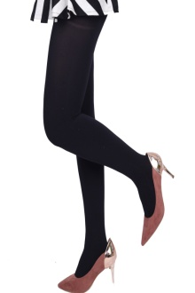
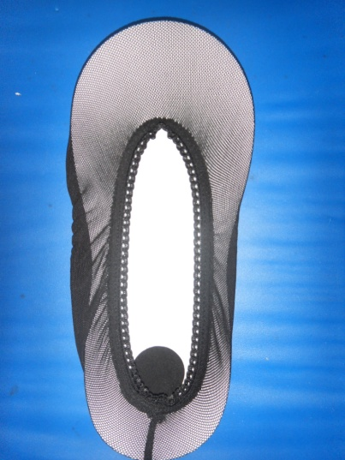
Ladie’s Lingerie Series-1
HC01001
HC01002
HC01003
HC01004
HC01005
HC01007
HC01008
HC01009

Slide 3
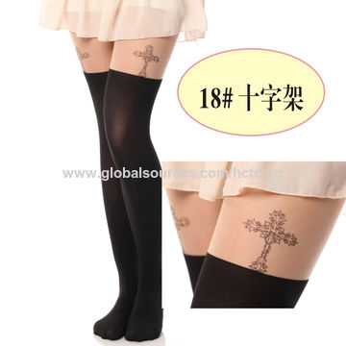
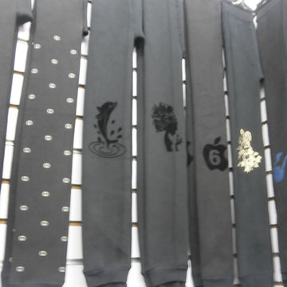
Ladie’s Lingerie Series-2
HC01010
HC01011
HC01012
HC01013
HC01014
HC01015
HC01016
HC01017

Slide 4
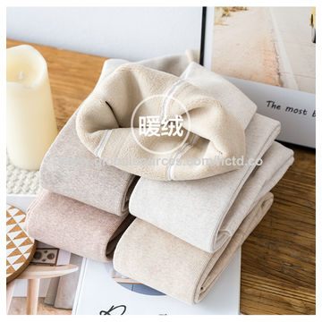
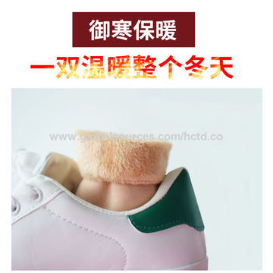
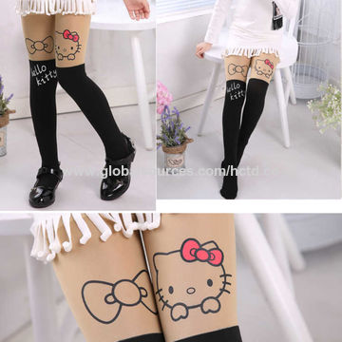
Ladie’s Lingerie Series-3
HC01018
HC01019
HC01020
HC01021
HC01022
HC01023
HC01024
HC01025

Slide 5
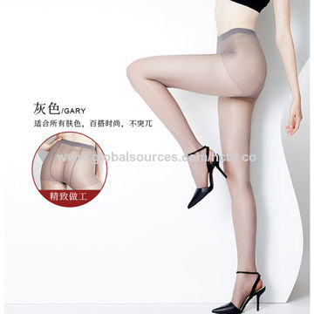
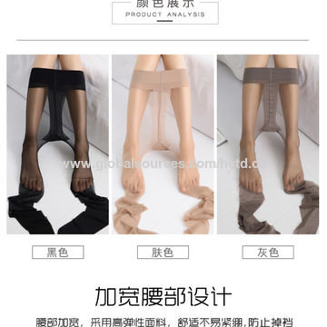
Ladie’s Lingerie Series-4
HC01026
HC01028
HC01029
HC01030
HC01031
HC01032
HC01033
HC01034

Slide 6
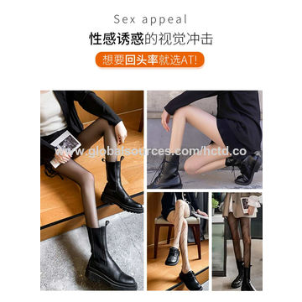
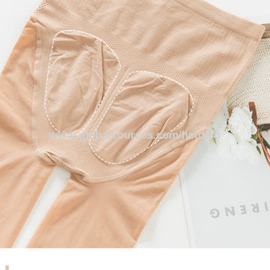
Ladie’s Lingerie Series-5
HC01035
HC01036
HC01037
HC01038
HC01039
HC01040
HC01041
HC01042

Slide 7
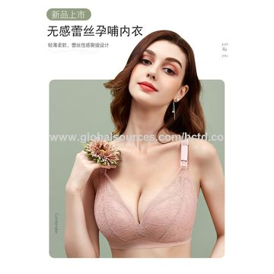
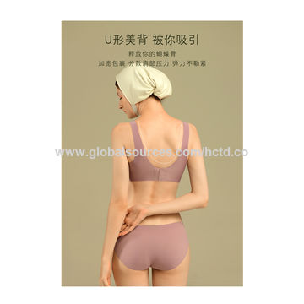
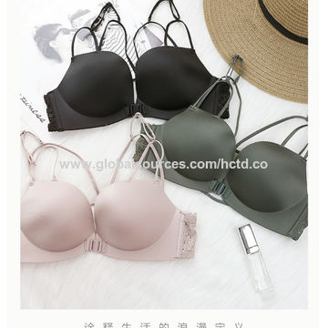
Ladie’s Underwear Series-1
HC02001
HC02002
HC02003
HC02004
HC02005
HC02006
HC02007
HC02008

Slide 8
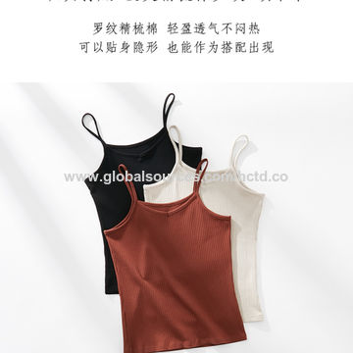
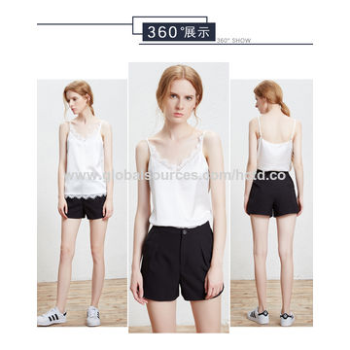
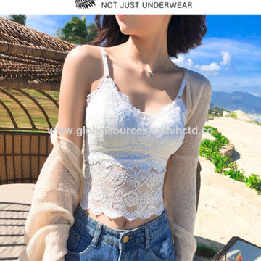
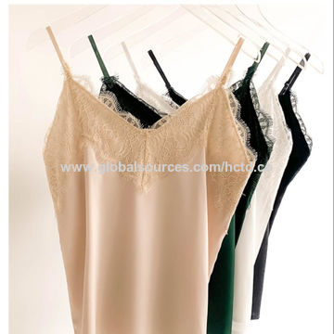
Ladie’s Underwear Series-2
HC02009
HC02010
HC02011
HC02012
HC02013
HC02014
HC02015
HC02016

